Slide 1
Integrate!geo Next generation tools for integration of large scale borehole fields in thermal networks
Alberto Lazzarotto, Marc Basquens, Massimo Cimmino

Slide 2
The project team
Alberto Lazzarotto, Researcher
Marc Basquens, Postdoc
Massimo Cimmino, Associate Professor

Slide 3
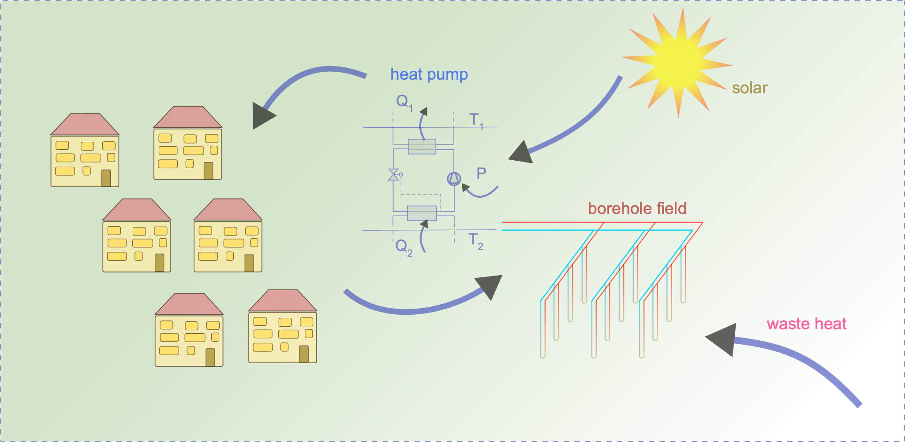
Geothermal integration in thermal networks
Geothermal can be used as thermal source or storage
The ground can be coupled with several systems: heat pumps, waste heat recovery, solar, distric heating, etc.
Thermal sources and needs can be intermittent
For flexible integration in thermal networks we need to be able to model the operation of geothermal with high temporal resolution

Slide 4
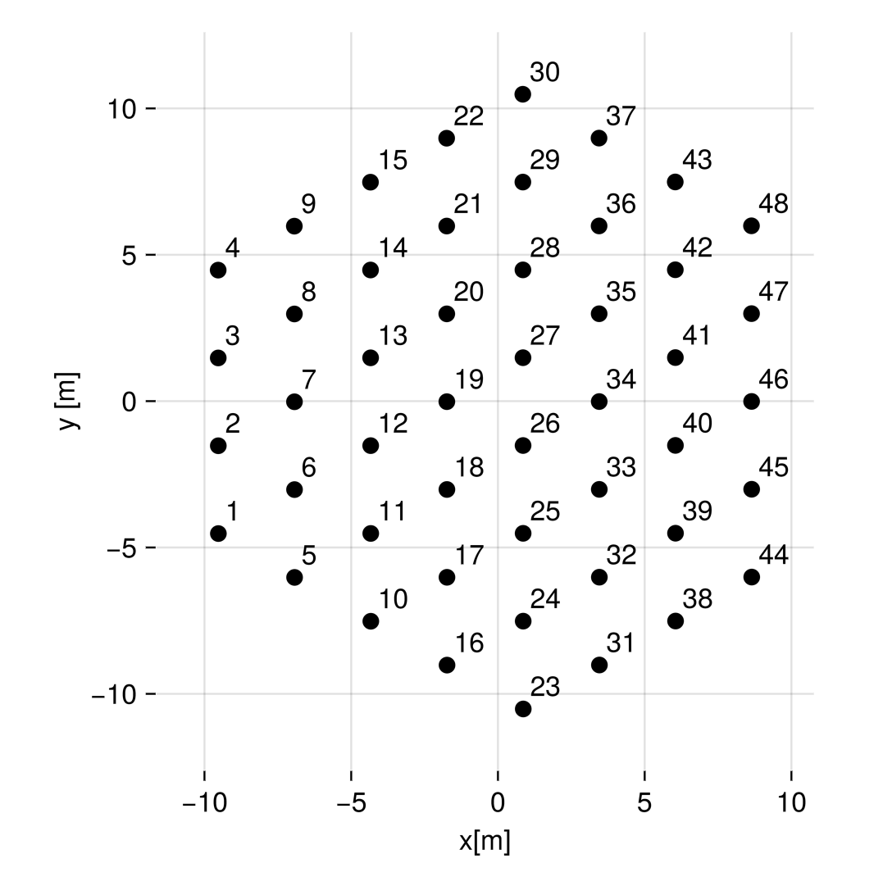
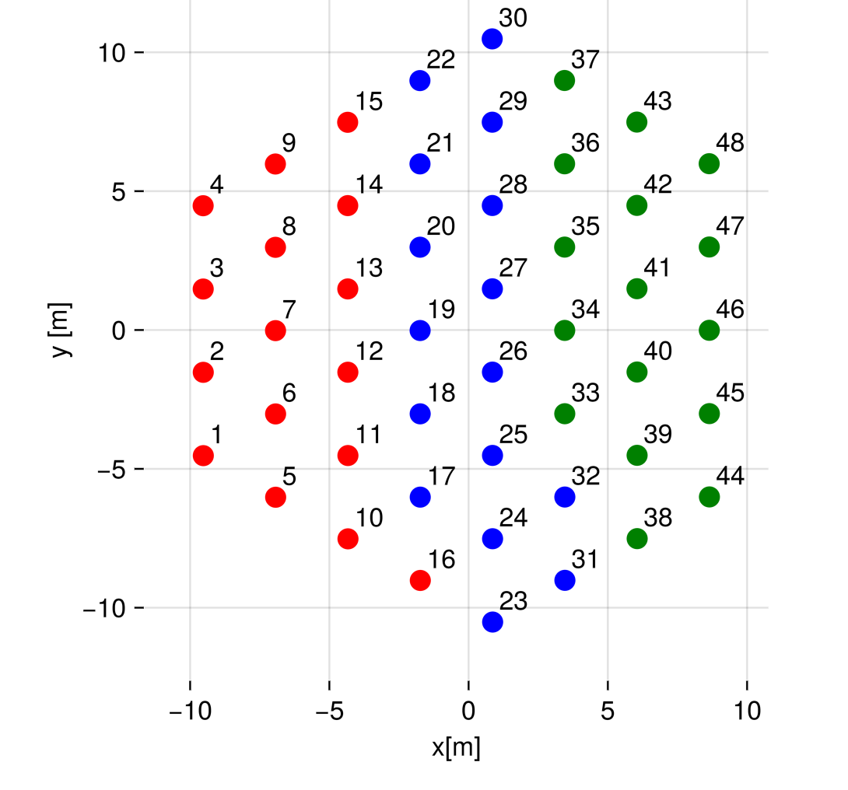
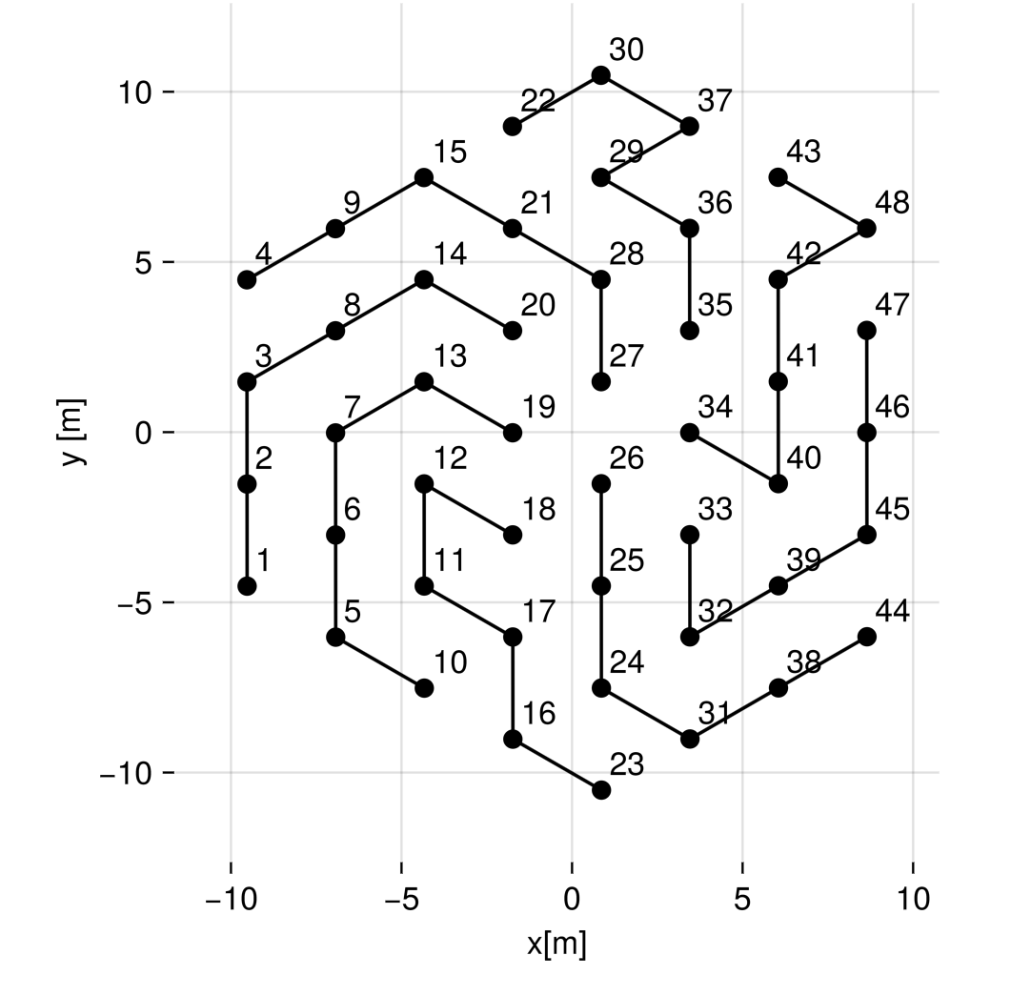
The borehole field can be fed and operated in different ways
Parallel
Zones
Series
Zone 1 Zone 2 Zone 3

Slide 5
Desired features for borefield simulations
large borehole fields
long term operation
short time-step (hourly) resolution
Flexible layout of borehole fields
Flexible topology of the hydraulic network
Fast computation
Is this even possible?
YES, if we improve the scaling properties of semi-analytical method for the simulation of boreholefields!

Slide 6
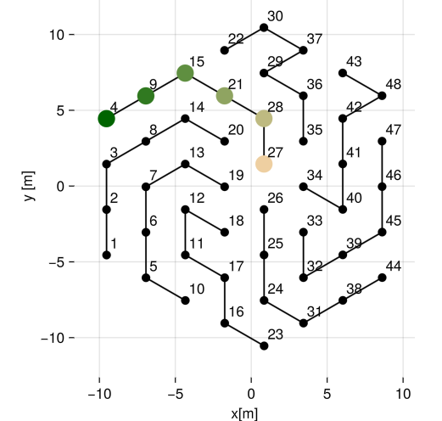
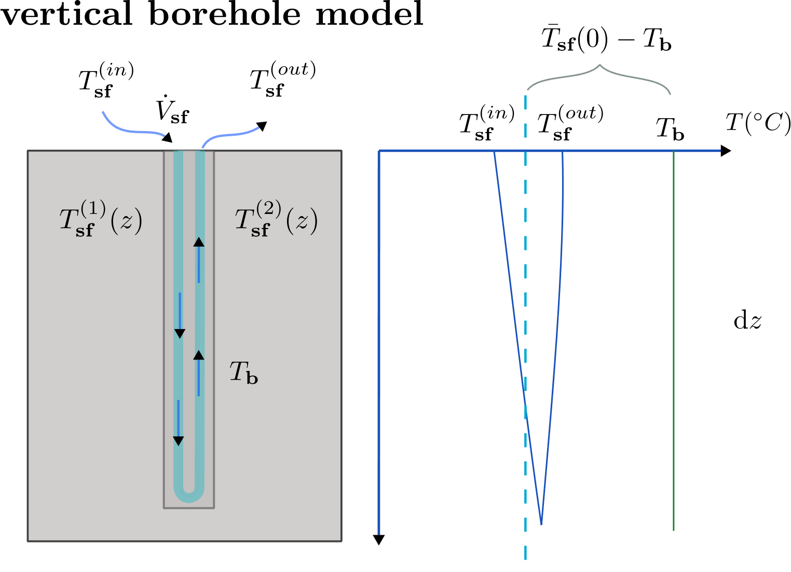
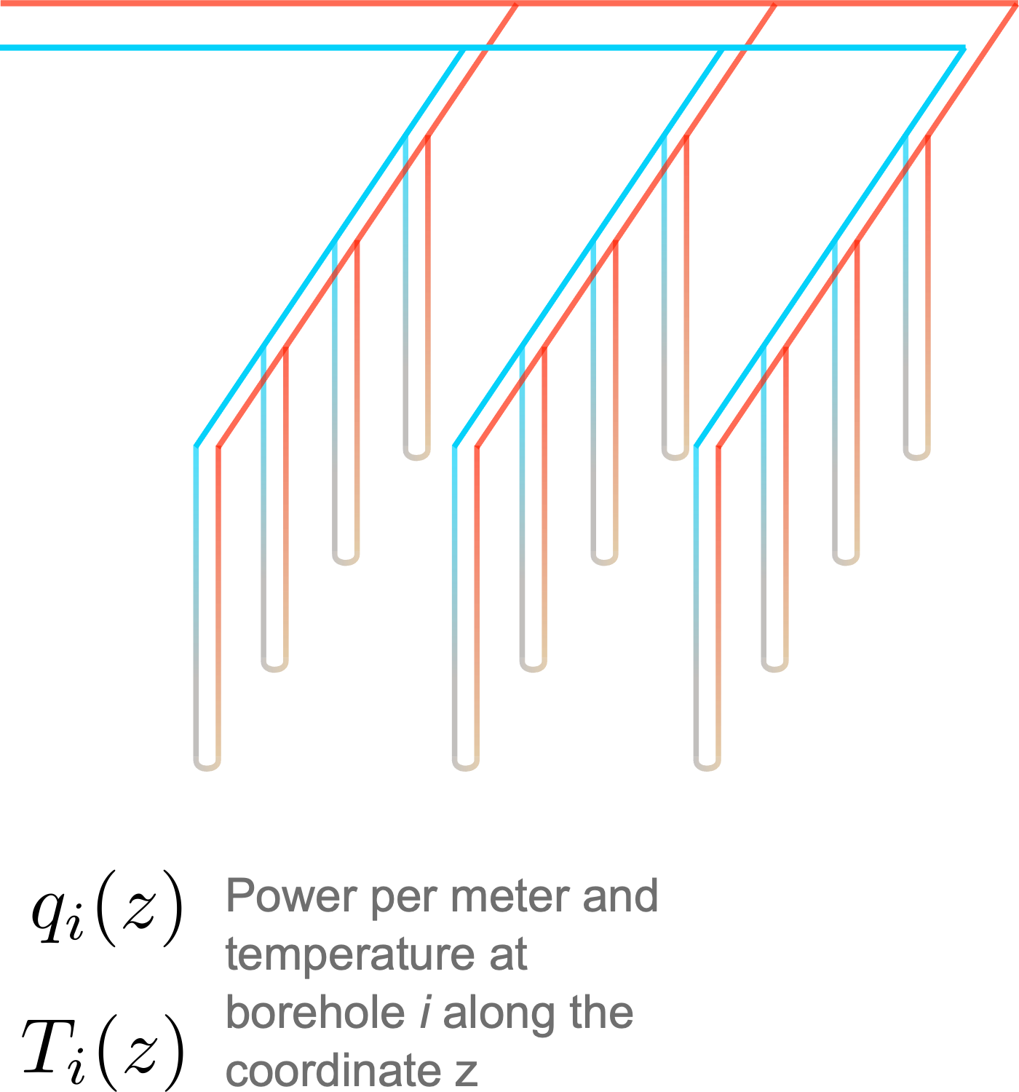
Network-based models
Borehole heat exchanger model
Thermal Interaction between boreholes.
Superposition of line sources in time and space
Hydraulic network topology
Putting together these 3 components and relative equations we assemble a linear system of equations A x = b
The unknonws x are relevant temperatures and powers.
Every time step, the given term b is updated to take account for the effect of interaction between boreholes.
The update of b is the costly operation.
Large part of this work has been making the computation of b faster and with better scaling properties as the problem size increases

Slide 7
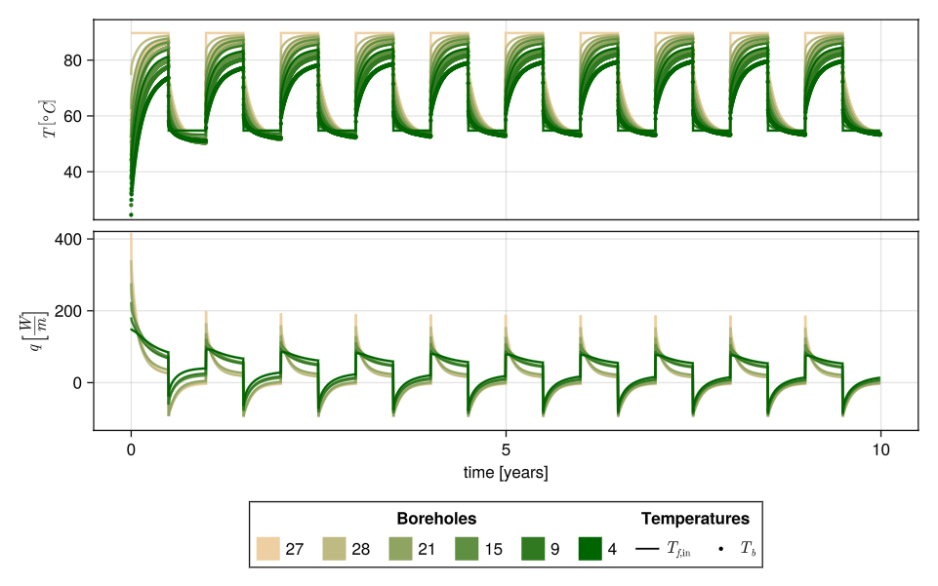
Simulation example
Configuration
U-pipe in series
Borehole length 75 m
Ground conduvtivity 3 W/m K
Flow rate 0.5 kg/s
Adiabatic boundary condition at the surface
Why do we need detailed models?
Why do we need high time resolution?
Charging Tin = 90 °C circulating from inner to outer borehole. Injection period is 6 month/year.
Extraction Tin = 55 °C circulating from outer to inner boreholes. Extraction period is 6 month/year
We show temperature and heat extraction per meter.
We compare continous exchange, with intermittent exchange

Slide 8
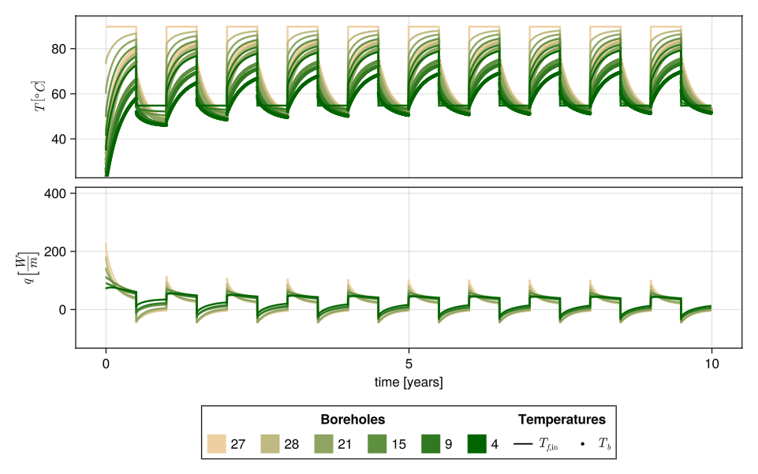
Long term operation
Intermittent exchange: only 12 hours of circulation per day.
The simulations below are hourly.
To display 10 years, we show daily average temperatures and heat rates.
Constant exchange
Intermittent exchange
Higher stratification
Higher overall heat exchanged
Higher heat injection ratio in the center of the storage

Slide 9
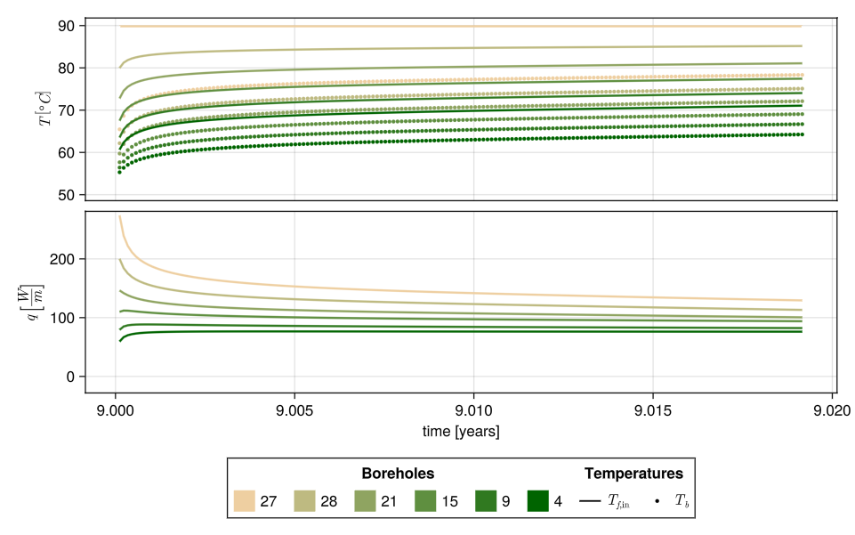
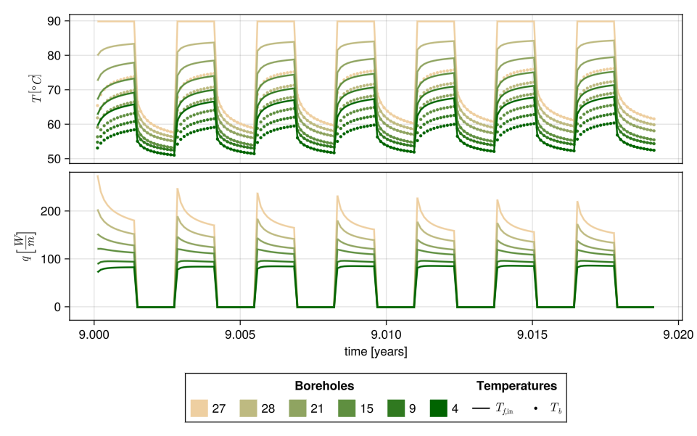
Week at the beginning of injection season
Alternating injection and recovery cycles over a day.
Heat transfer in the rock is slow.
The recovery gives time for the heat to flow from the borehole to the surrounding rock.
Constant exchange
Intermittent exchange
Recovery
Recovery
Recovery
Recovery
Recovery
Recovery
Injection
Injection
Injection
Injection
Injection
Injection
Injection

Slide 10
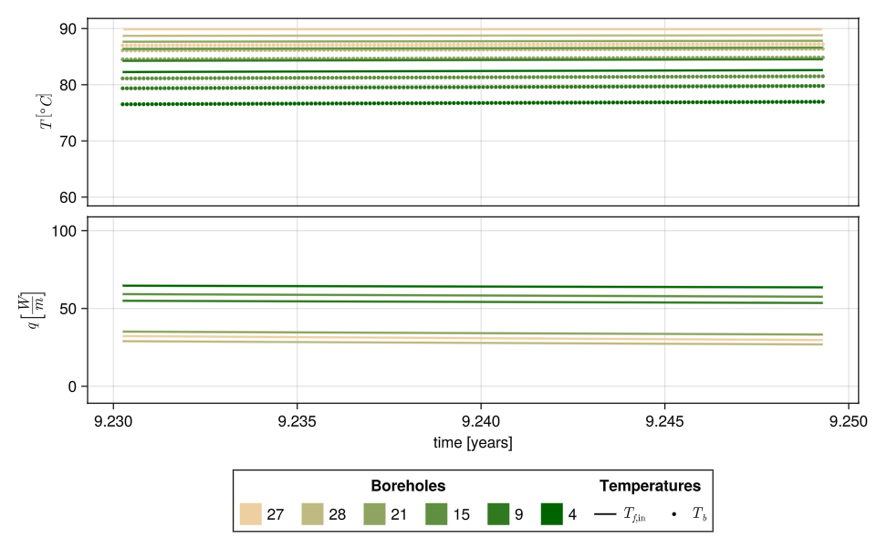
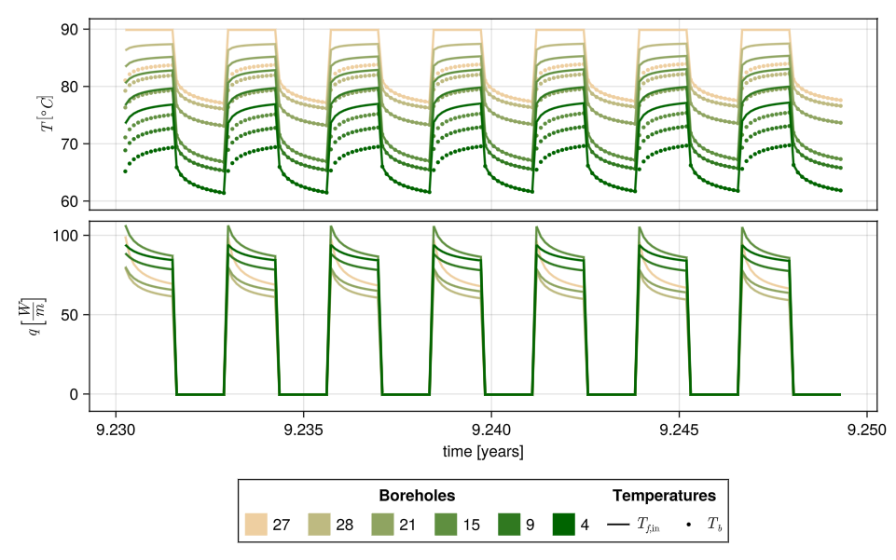
Week at mid injection season
With intermittent operation it is still possible to effectively inject on the center boreholes after 3 months of the charging.
With intermittent operation we have higher stratification.
Constant exchange
Intermittent exchange
More uniform injection among boreholes
Injection in the center boreholes is lower

Slide 11
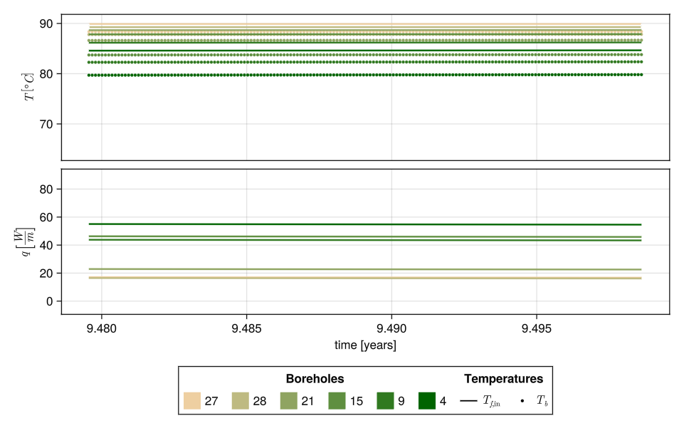
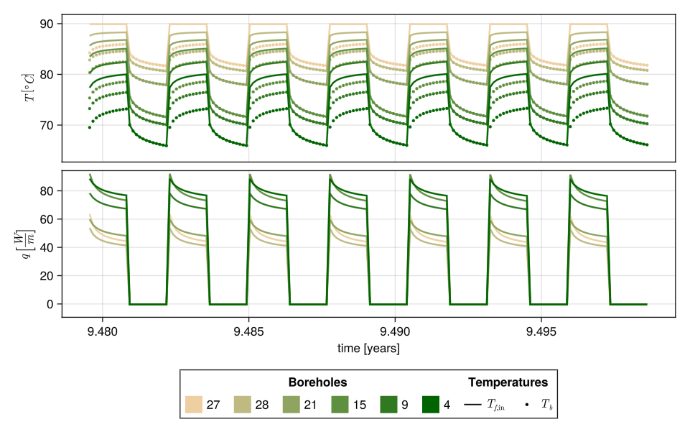
Week at the end of injection season
With intermittent operation it is still possible to effectively inject on the center boreholes at the end of the season
The power is higher because we can take advantage of the higher stratification.
Constant exchange
Intermittent exchange
Injection in the center boreholes is significantly lower
Injection in the center is still rather high

Slide 12
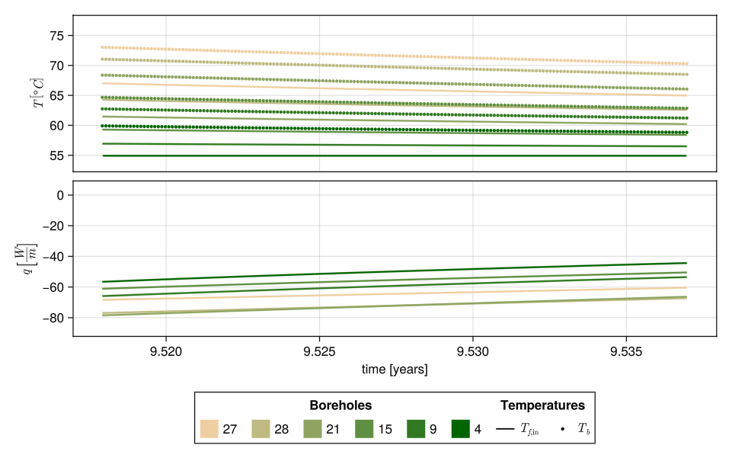
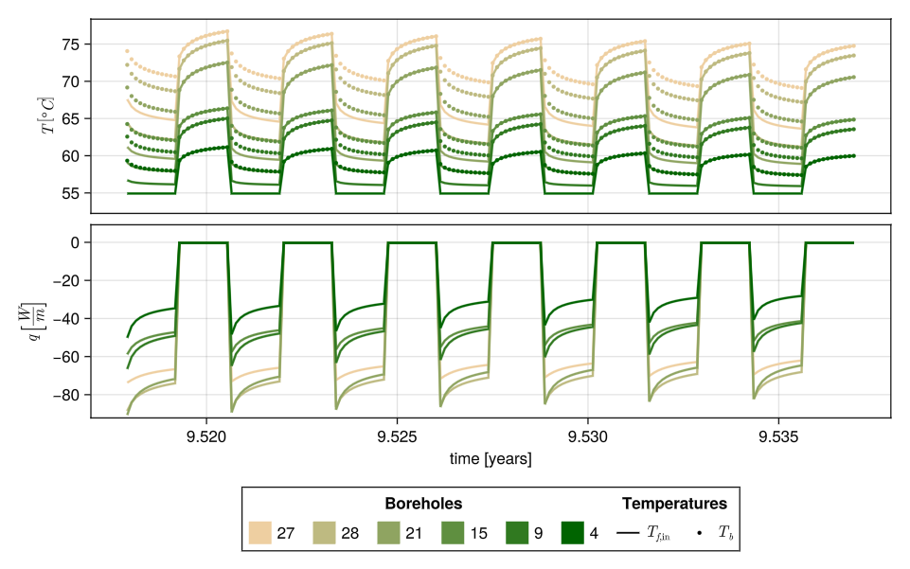
Week at the beginning of the extraction season
For intermittent operation we mostly extract from the inner boreholes
Constant exchange
Intermittent exchange

Slide 13
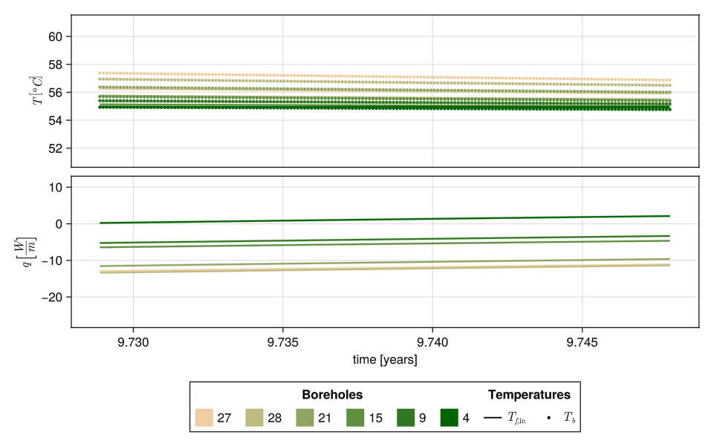
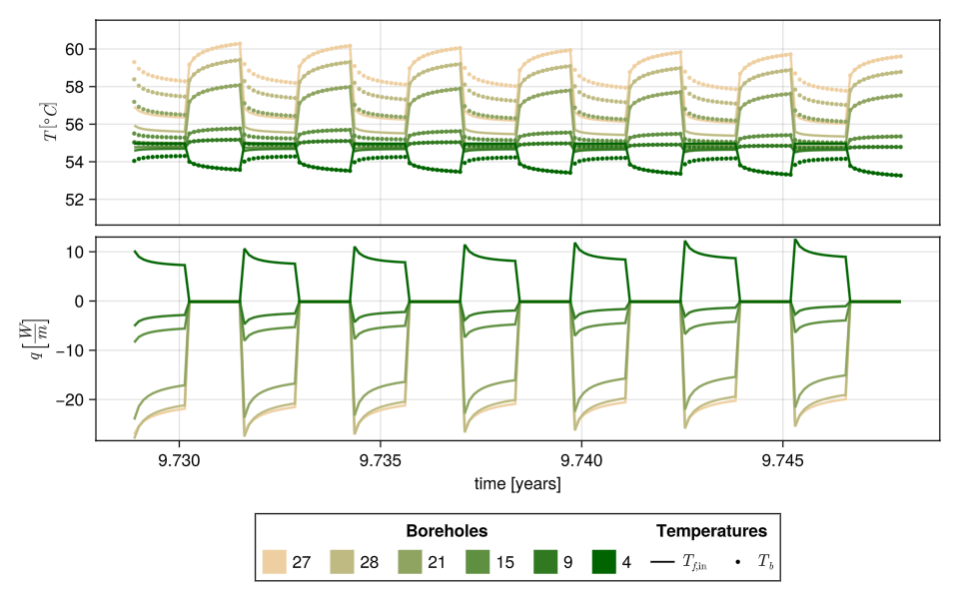
Week at mid extraction season
At mid extraction season intermittent exchange with inlet temperature 55°C results in injection in external boreholes as they are at a lower temperature
Constant exchange
Intermittent exchange
At mid extraction season the next exchange with the external borehole is zero
At mid extraction season we are injecting in the external borehole

Slide 14
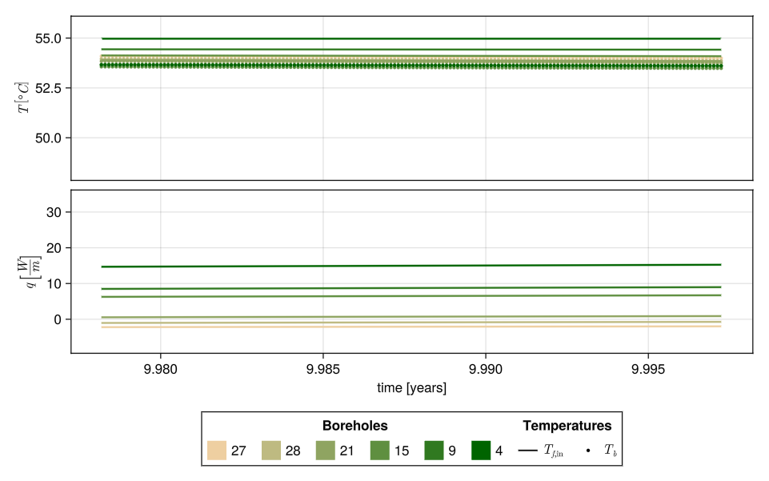
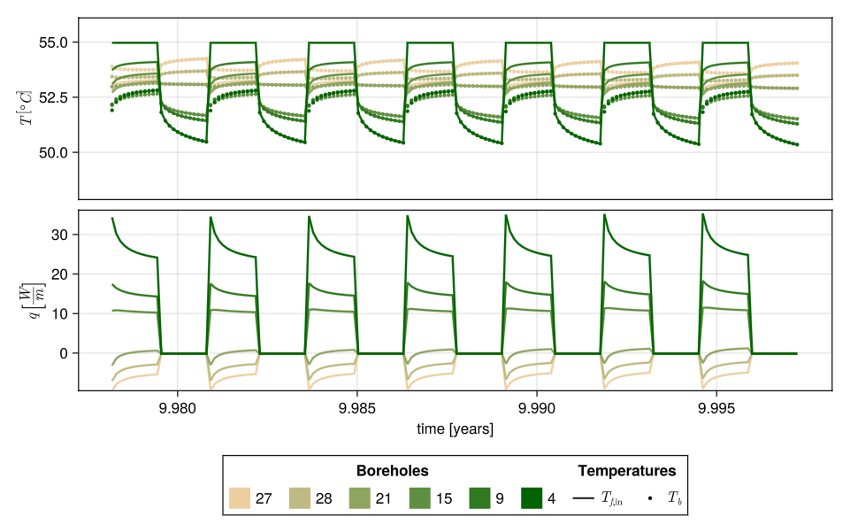
Week at the end of extraction season
At the end of the extraction season we have a similar effect for the continous and intermittent exchange case.
In both cases, only the three internal boreholes in the series can extract if the inlet temperature is 55°C.
Constant exchange
Intermittent exchange
At the end of the extract season we are injecting heat in the storage

Slide 15
Detailed model allows to investigate how the heat is distributed in the subsurface.
Hourly resolution combined with detailed borehole network modeling allows to represent complex operations.
The overall heat exchange is not imposed but is the result of the simulation.
Operation affects the distribution of heat, and in turn the temperature in the storage.
Intermittent operation results in higher stratification, and extraction temperatures.

Slide 16
Computational Complexity
Large part of this work has been making the computation of superposition of the effect in time and space faster and with better scaling properties as the problem size increases
In the naïve implementation of superposition, the number of operations is proportional to the square of the number of sources and to the square of the number of time steps
O(N_{sources} ² N_{timestep} ²)
EXAMPLE: effect of increase in time resolution
10 years DAILY simulation
N_{timestep} = 365 day/year x 10 years = 3650 days
N_{timestep} ² = 3650 ² ≅ 1.3 x 10^7
10 years HOURLY simulation
N_{timestep} = 8760 hour/year x 10 years = 87600 hours
N_{timestep} ² = 87600 ² ≅ 7.6 x 10^9
THE NUMBER OF STEPS INCREASE BY A FACTOR 24
BUT THE NUMBER OF OPERATIONS IN THE SIMULATION INCREASE BY A FACTOR 24^2 = 576

Slide 17
Contribution to the reduction of complexity associated to the time superposition
Load aggregation method
We proposed a variation of the load aggregation method for borehole fields were far field interactions are treated differently compared to close field thermal interaction.
Effect of thermal interaction between boreholes can be solved less frequently than every hour (e.g. every week) .
Non-history dependent acceleration method
We made significant developments to the non-history acceleration method of Lamarche.
We showed that for point sources the method can be expressed with an analytical expression.
The extension to line sources, relevant for borehole simulation, has been also investigated.
Load aggregation and Non-history acceleration method have LINEAR SCALING as opposed to square scaling of the naïve implementation of convolution.
In the non-history method the error can be controlled.
The load aggregation is more intuitve and simple to implement

Slide 18
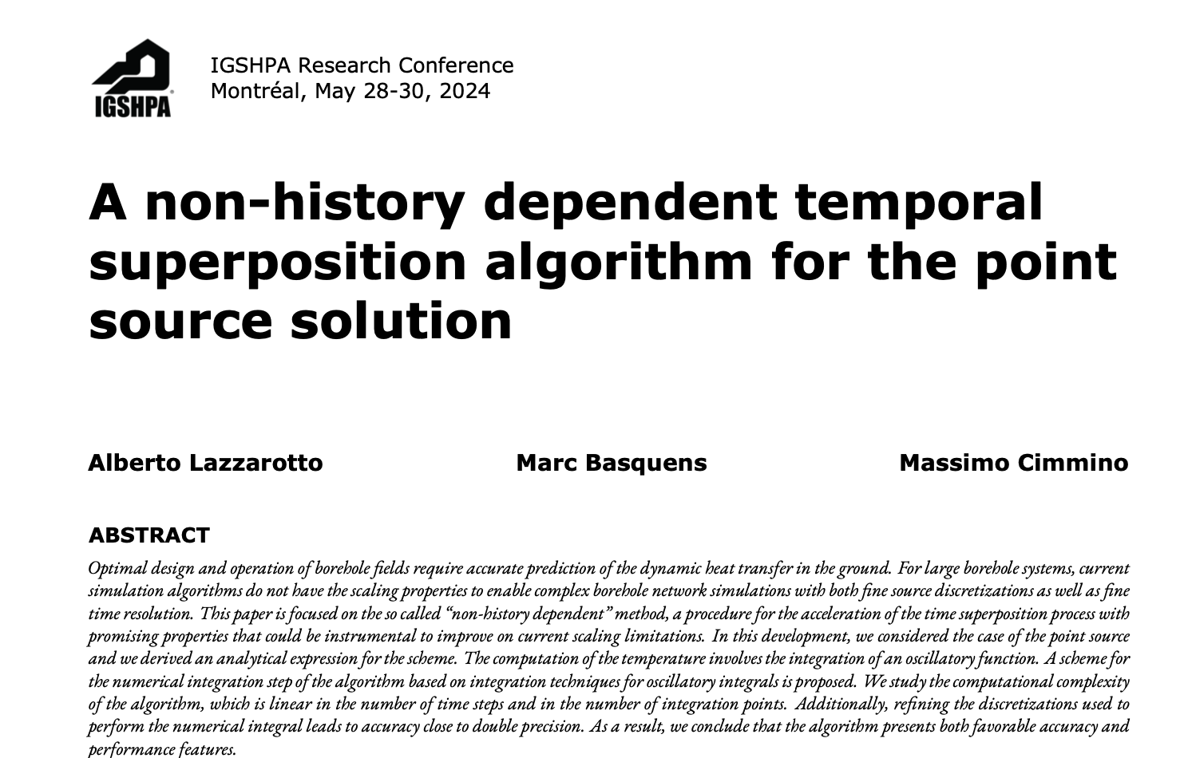
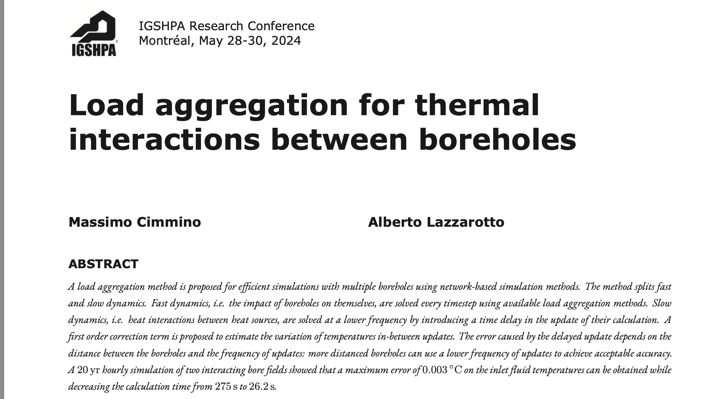
Publications
A non-history dependent temporal superposition algorithm for the finite line source solution Alberto Lazzarotto, Marc Basquens, Massimo Cimmino (submitted to journal) https://arxiv.org/abs/2501.16027
Higher-order semi-analytical model for the simulation of geothermal boreholes Massimo Cimmino, Marc Basquens, Alberto Lazzarotto (submitted to journal)

Slide 19
Models developed
BoreholeNetworksSimulator.jl : an open source software to simulate borehole networks which offers the possibility to simulate complex operations of the system. The model offer an implementation of the non-history acceleration algorithm for the time superposition. https://github.com/marcbasquensmunoz/BoreholeNetworksSimulator.jl
Geothermsim: an open-source semi-analytical transient heat transfer modeling tool for geothermal borehole fields. The method uses high-order piecewise polynomial approximations of heat extraction rates along line trajectories representing the boreholes and evaluates ground temperature changes from the spatial and temporal superposition of heat source solutions. Quasi-steady-state variations of heat carrier fluid temperatures inside boreholes are evaluated by leveraging the multipole method to build and solve a system of ordinary differential equations. https://github.com/MassimoCimmino/geothermsim

Slide 20
Conclusion
We studied and implemented acceleration algorithms to improve the scaling of borehole field simulations.
We developed algorithm and tools to enable the simulation of detailed borehole networks operations
We demonstrated the application and relevance of such simulations through examples.
Future work
Improve scaling in the number of sources to speed up simulations of large borehole field and to enable more flexibility in the boundary conditions.

Slide 21
Thank you for your attention!

Slide 22
The methodology
We use semi-analytical model of the ground
Borehole are modeled as line heat sources
The temperature is obtained as superposition in time and space of the effect of these sources
Advantages:
The domain is not discretized we only discretize the sources.
The problem can be described with a relative low amount of variables (i.e. power heat power and temperatures along the borehole)
Modeling through line source is an effective and elegant way to deal with the extreme aspect ratio of boreholes which is inconvenient for methods using domain discretizations
These methods are fast, accurate and suitable for the simulation of long operation of borehole systems
Limitations:
There are currently limitations in the boundary conditions that can be used.
The computation scale with the square of the number of sources and on the number of time-steps

